Slide 1
Market Magician Algorithmic Trader
Artificial Asynchrony
CS691
Sep 2024
Notes:
Kassandra: introduces team and project

Slide 2
Agenda
Team Intro
Member Names
Roles and Responsibilities
Project Overview
Problem Statement
Project Description
Personas
MVP
Software Tools
Technologies
Algorithms
Diagrams
6. Product Backlog
7. Sprint Backlog
Metrics
8. Retrospective
9. Demo
10. Github Link
Notes:
Kassandra: overview of agenda

Slide 3
Team Roles and Responsibilities
Kassandra Camarillo – Team Leader
Henry Kim – Scrum Master
Abed Mussawi – Developer
Andrew Rowan – Developer
Aviel Sanchez - Developer
Notes:
All: everyone give brief intro of name and team role

Slide 4
Problem Statement
Currently, there is a lot of interest in the stock market. Sometimes it could be confusing and daunting to invest money in the stock market since there is a lot of information and it is difficult to access. Our application will make it much easier and more accessible to the greater public to invest more wisely and with the power of data at their back.
Notes:
Andrew/Abed

Slide 5
Project Description
An AI that uses historical data, news flow, and intra-day trading data to determine entry and exit points of a stock or fund using a trained regression model in order to maximize profits.
This is for Daily traders and Investors
who want to improve predictive capabilities,
the webb App is a tool to help both large and small capital investors and traders predict market trends faster than a human could.
This subscription service unlike hedge funds, where you need to pay a lot of money out of pocket to manage your investments, or risk trading personal funds with untested strategies,
our application provides an easy way to invest and trade your securities to minimize risk and maximize profits
Notes:
Andrew/Abed

Slide 6
Project Schedule
Meeting Cadence
Twice a week (Sat, Mon)
Additional meetings scheduled ad hoc based on team needs
Text Based Daily Scrum
Asynchronous team makes daily scrums impractical
Substitute with text based check in
Notes:
Henry

Slide 7
Team Working Agreement
Scheduling meetings
Communications
Technologies used
Tentative schedule
Respect
Notes:
Avi

Slide 8

Alex Woods - Retail Investor
Age: 23
Location: Arlington, Virginia
Occupation: Nurse / recent graduate
Alex is a recent graduate who wants to start investing but has limited money and a bit of experience. She is looking for an affordable and user friendly platform that can help her enter the investment world without the need for deep financial knowledge.
Using our app will offer her personalized and ease to use market data which will make investing more accessible for beginners like Alex.
Notes:
Abed

Slide 9

Jaylen Washington - Financial Advisor
Age: 33
Location: Austin, Texas
Occupation: Financial Advisor
Jaylen is a financial advisor who assists individuals with decisions about their money. He offers advice on investments, taxes, and insurance.
Using our app will offer him a useful analysis tool that supplements his advisement strategy with AI backed assessments. This could cut down on his research and analysis, saving time and money.
Notes:
Abed

Slide 10

James Smith - Hedge Fund Manager
Age: 35
Location: San Francisco, California
Occupation: hedge fund manager
James is an experienced hedge fund manager and is always on the look up for new and innovative tools to enhance his investment strategies. James understands that now a days AI models are important tools and are more efficient than using traditional methods.
Using our app will offer him cutting edge algorithms and data analysis which can be a great asset to a better investment in combination with his expertise.
Notes:
Abed

Slide 11
Minimum Viable Product
The most important capability of the application is the stock price prediction
This prediction relies on a good model
Therefore, MVP for Market Magician must do the following
Train a model based on selected stock price history
Predict future prices for selected stock
Notes:
Henry

Slide 12
Technologies
Python
JavaScript
Machine Learning
TensorFlow
Keras
Django
HTML
CSS
Reactjs
PostgresSQL
Y!finance
Github
VSCode
Notes:
Andrew

Slide 13
Algorithms
Linear Regression
Poor Prediction Capabilities
Long-Short Term Memory
Needs Activation Function
Monte Carlo
Continue research on implementation
Notes:
Andrew

Slide 14
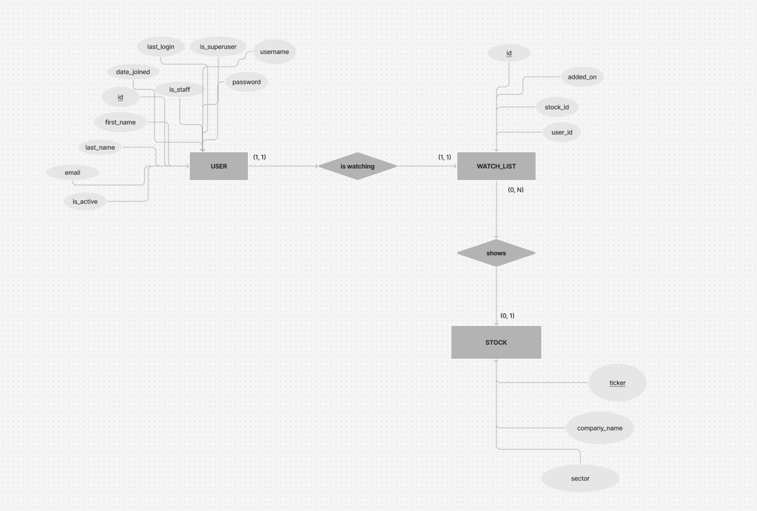
Entity-Relationship Diagram

Slide 15
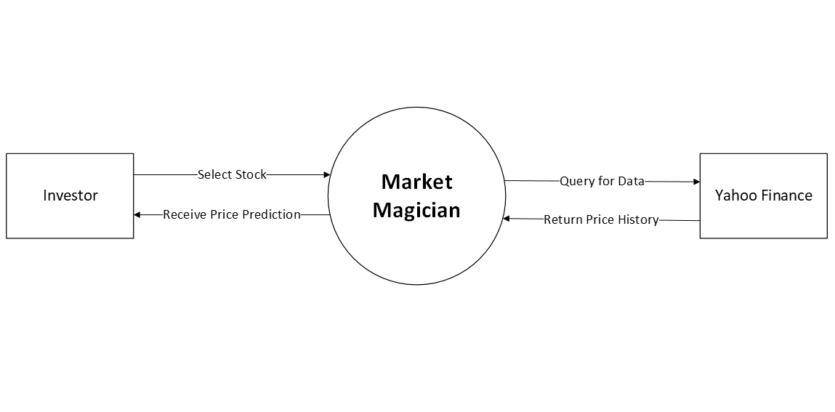
Context Diagram

Slide 16
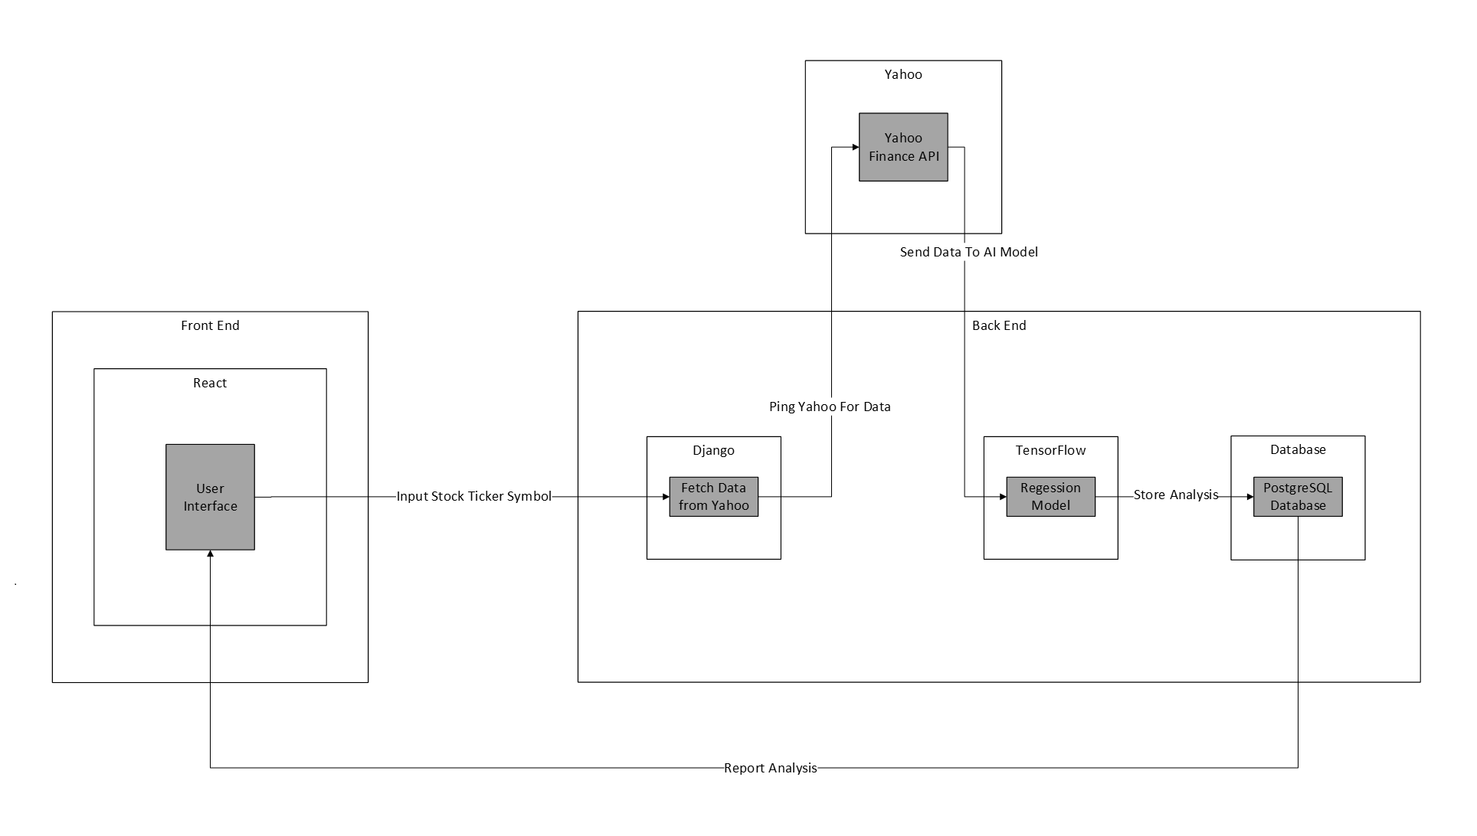
Architecture Diagram

Slide 17
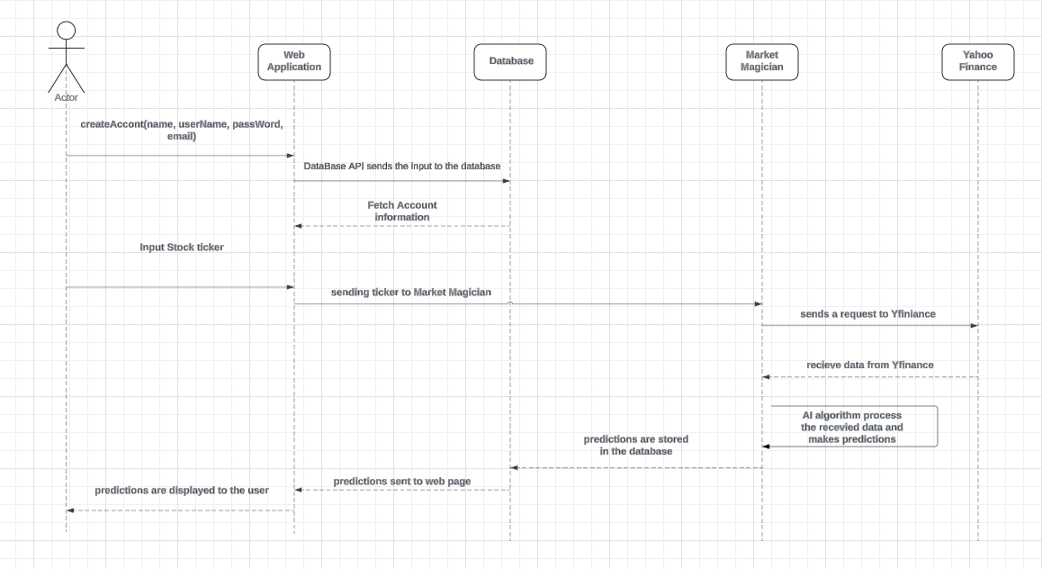
Sequence Diagram

Slide 18
Product Backlog
Team collaborated on a list of user stories to guide application development
Stories pulled into backlog
Backlog refinement will be necessary
Notes:
Henry

Slide 19
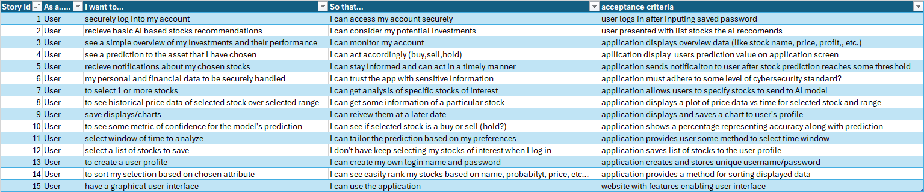
Product Backlog
Notes:
Avi

Slide 20
Sprint 1 Backlog
Sprint 1 backlog consisted of developer tasks related to:
Capstone project tasks
Prototype development tasks
Detailed sprint export within team repo
Notes:
Henry

Slide 21
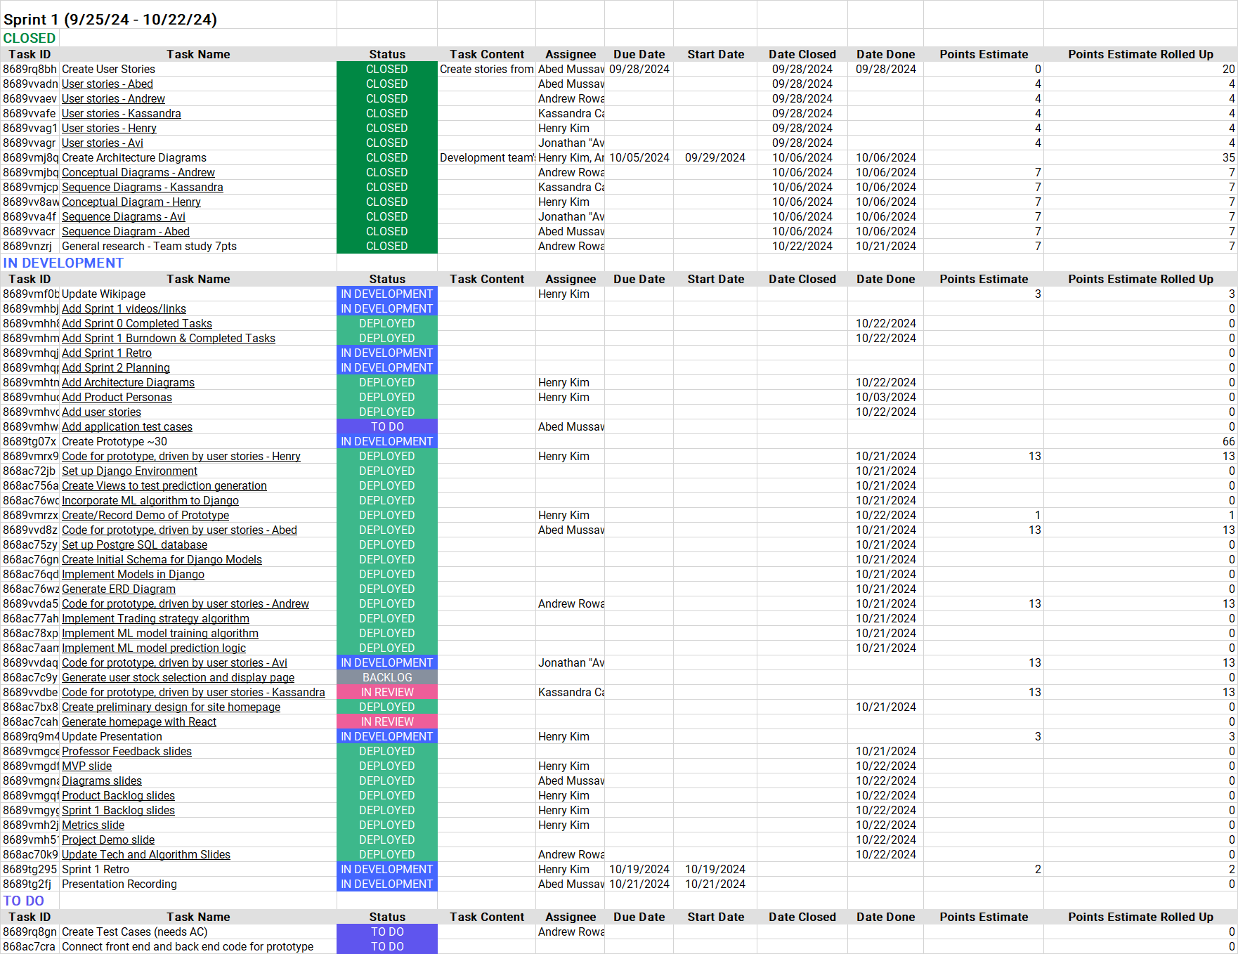
Sprint 1 Backlog
Notes:
Avi

Slide 22
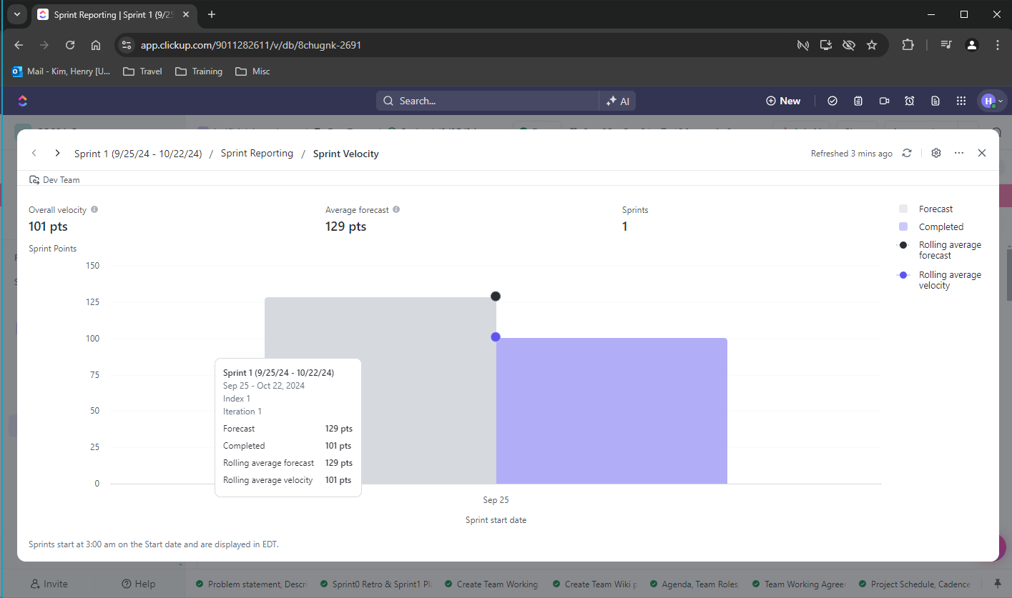
Team Velocity
Notes:
Avi

Slide 23
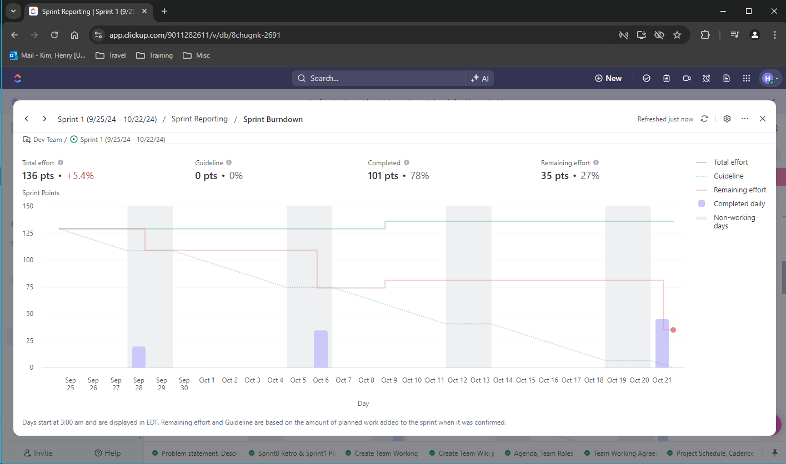
Sprint 1 Burndown
Notes:
Avi

Slide 24
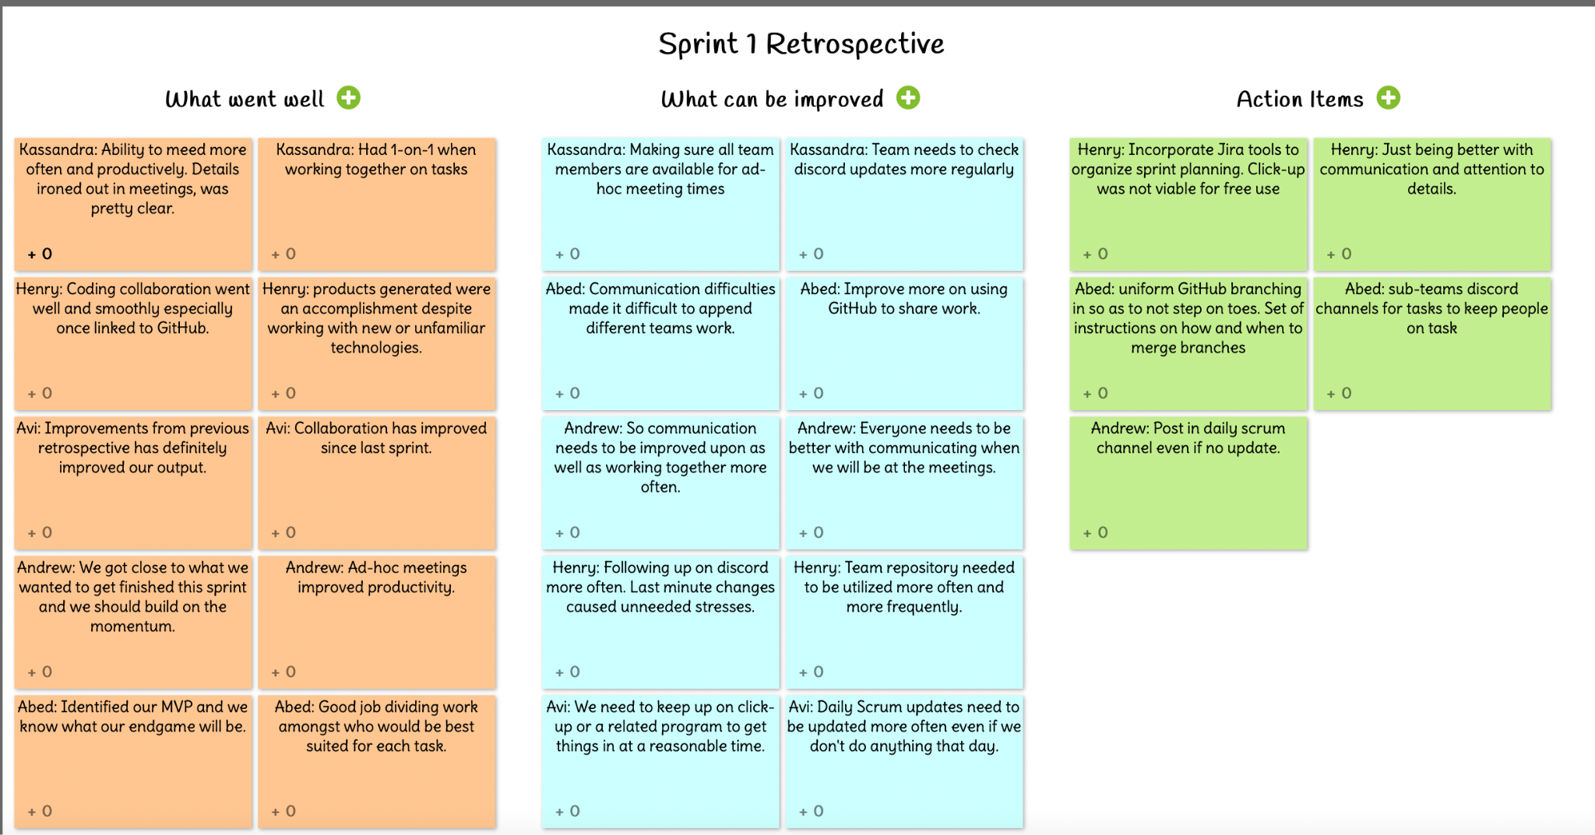
Sprint 1 Retrospective
Notes:
Henry

Slide 25
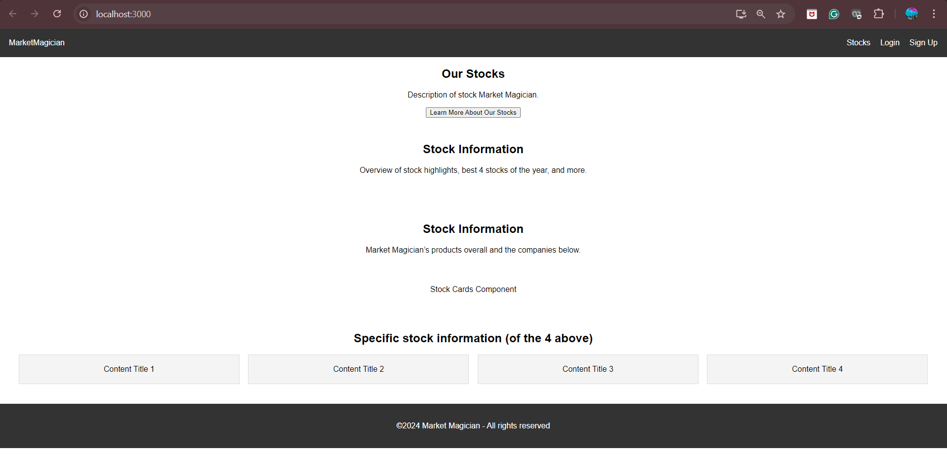
Landing Page Website

Slide 26
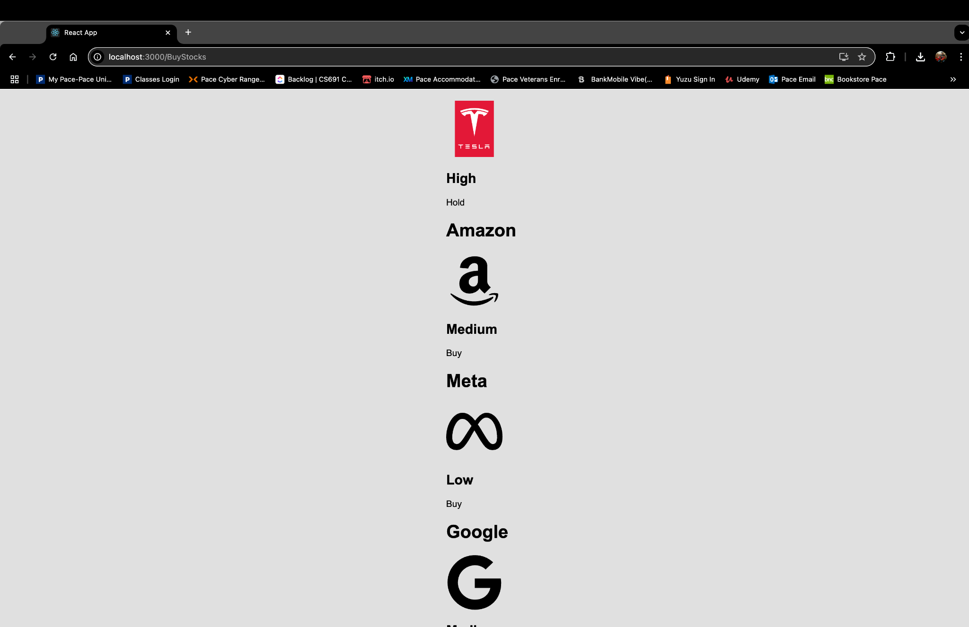
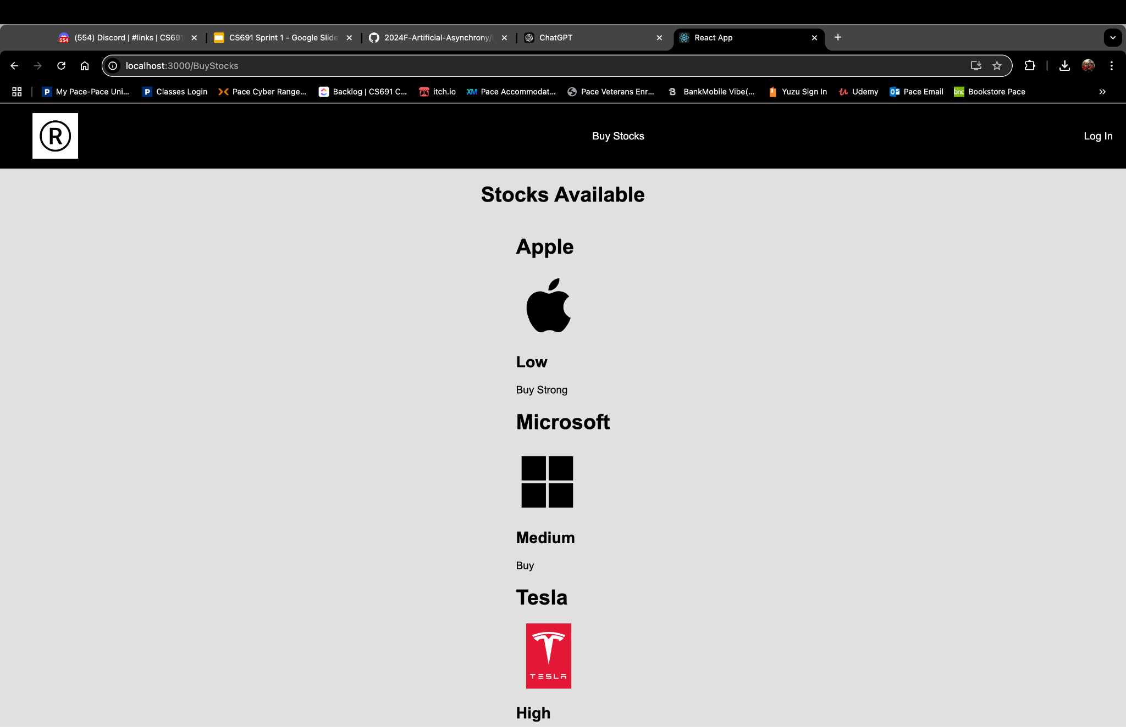
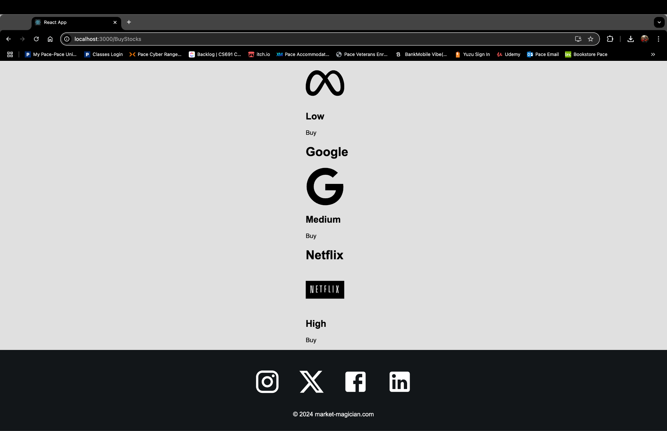
Buy Stocks Page

Slide 27
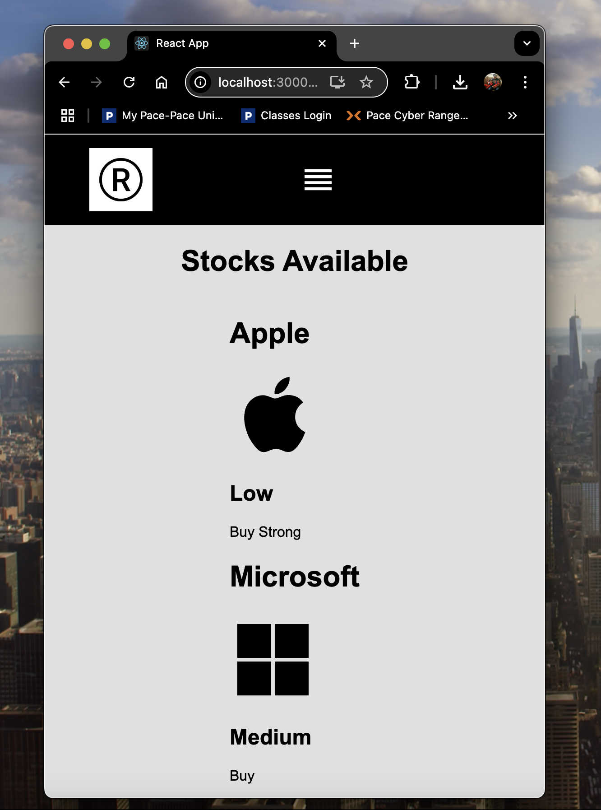
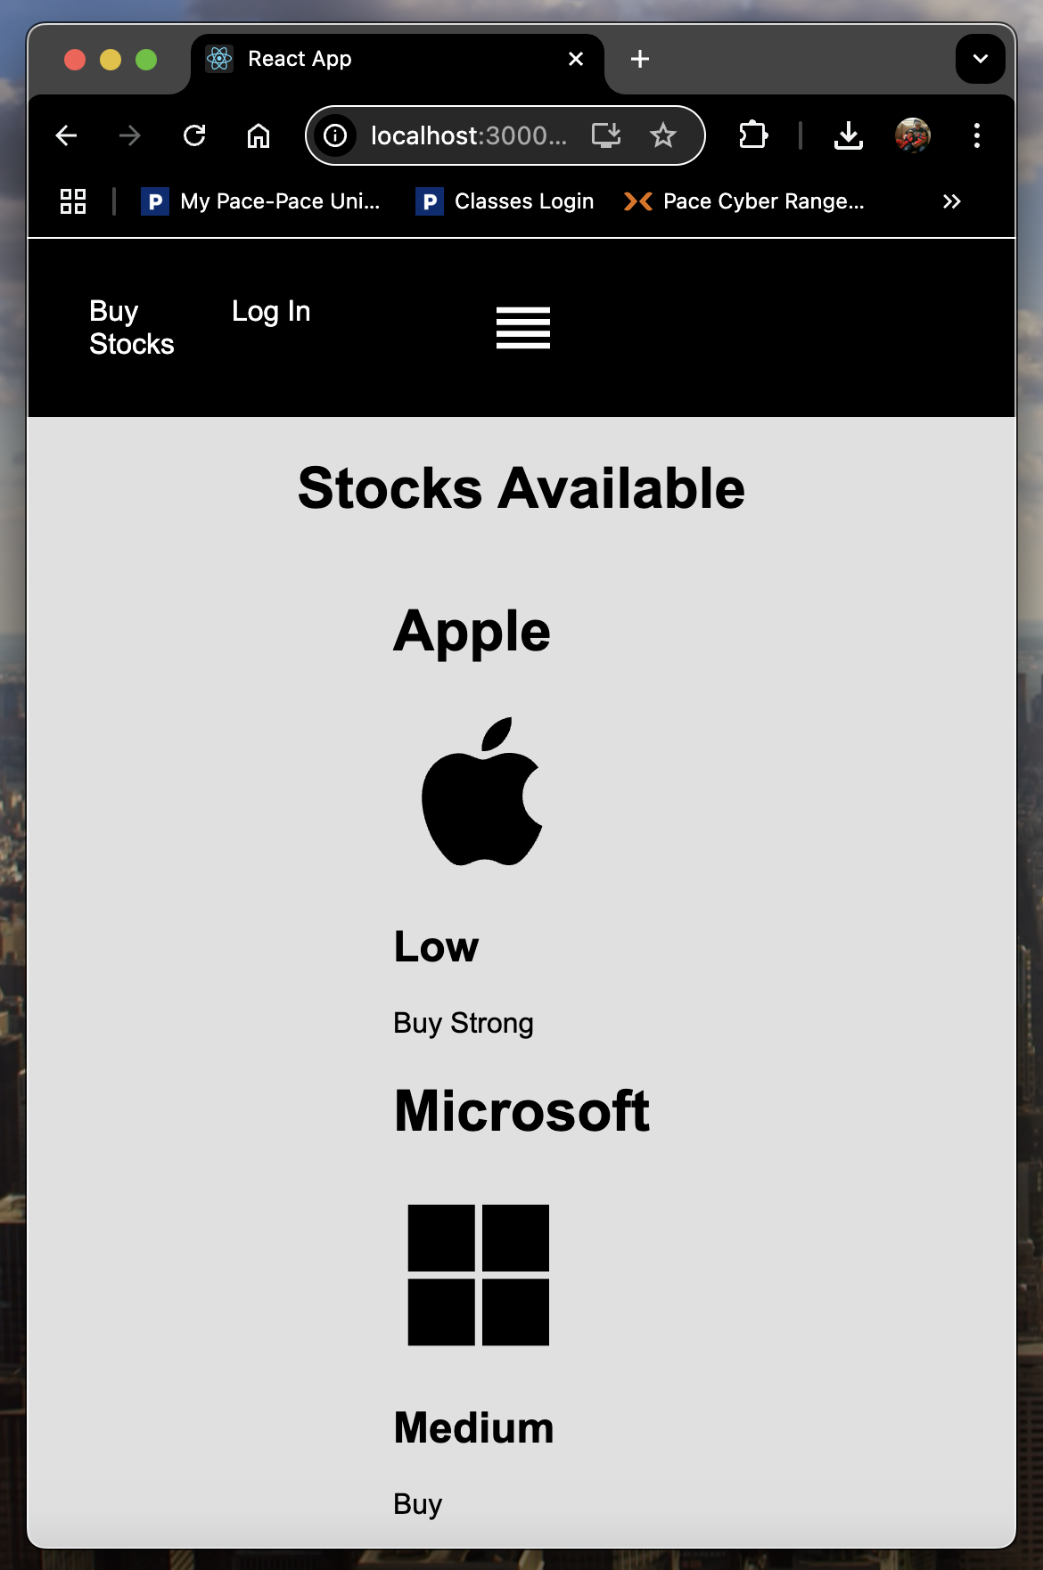
Buy Stock Page

Slide 28
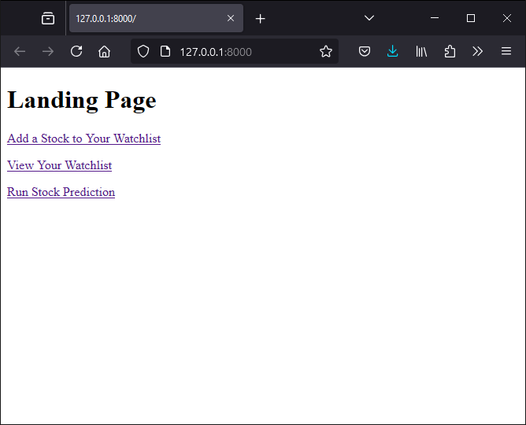
Backend Landing Page
Notes:
Avi

Slide 29
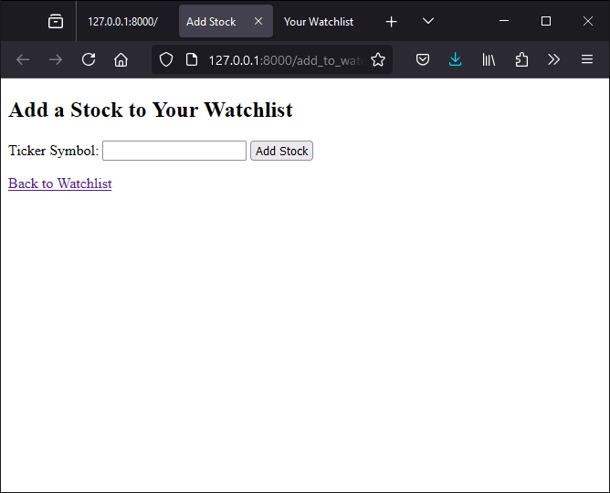
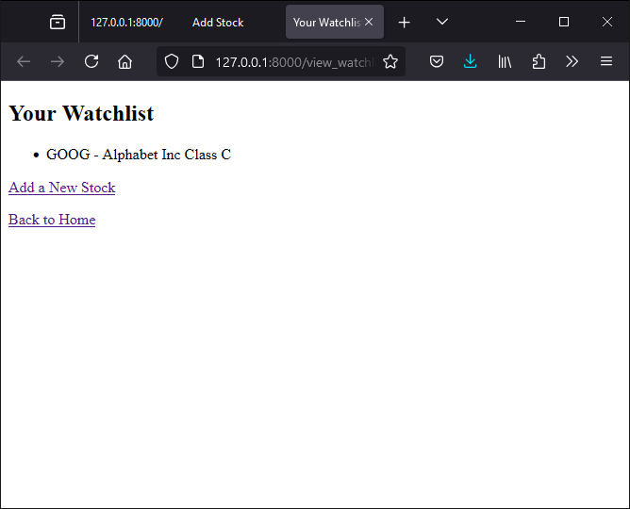
Stock and Wishlist Pages
Notes:
Avi

Slide 30
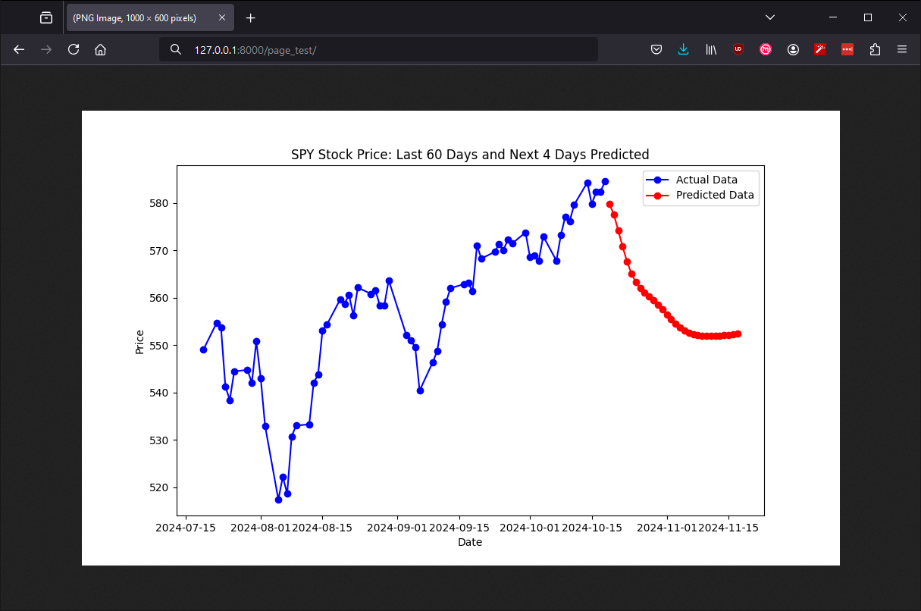
Prediction Plot
Notes:
Avi

Slide 31
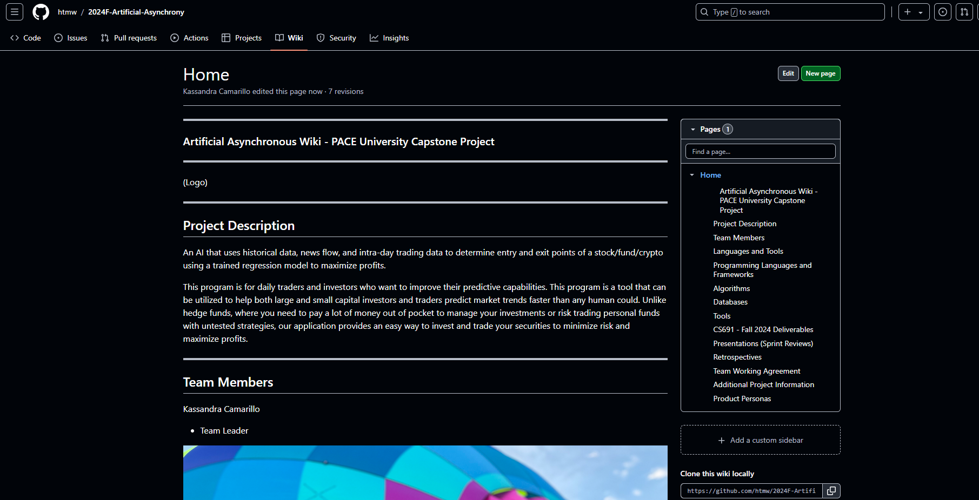
Wikipage Link
https://github.com/htmw/2024F-Artificial-Asynchrony/wiki

Slide 32
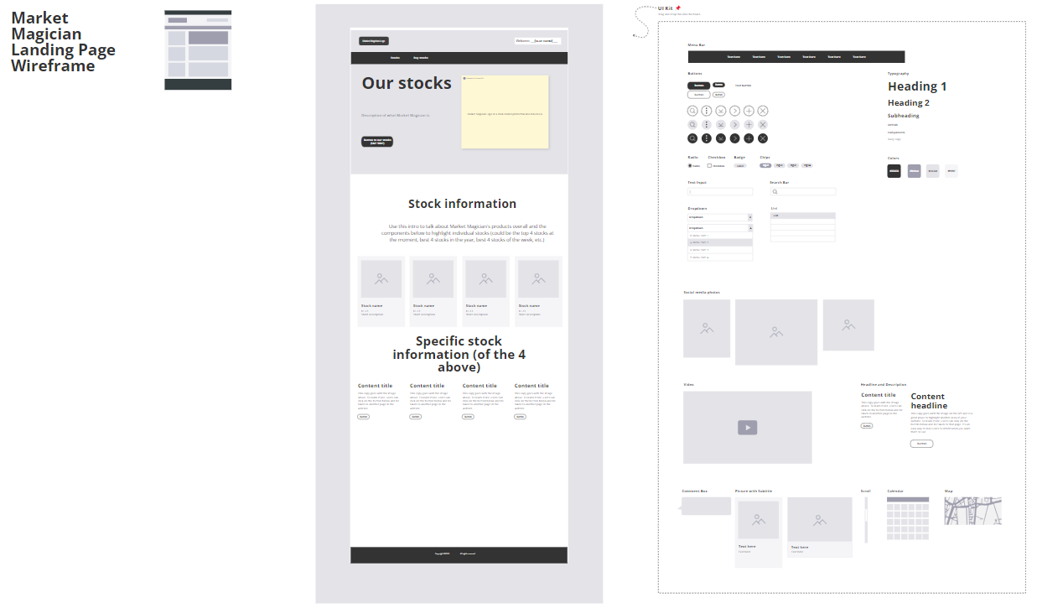
Landing Page Mockup

Slide 33
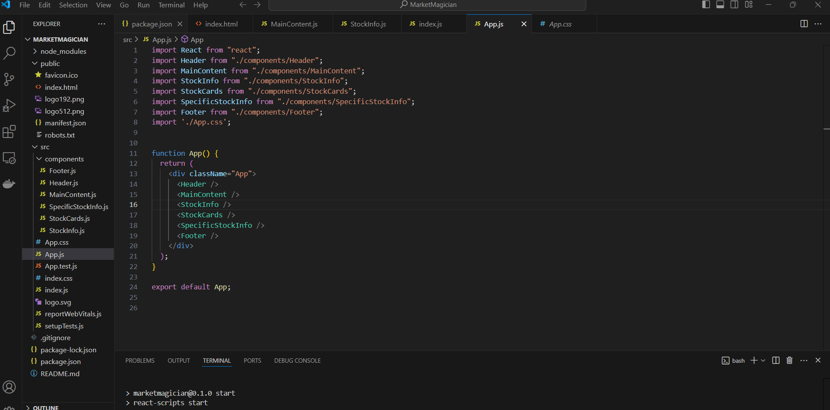
Landing Page Website Code

